Slide 1
Resistance

Slide 2
By the end of this lesson you will be able to:
Explain what resistance is.
Describe how resistance is affected by the length, width and materials of wire.

Slide 3

Sometimes it is difficult for a current to flow through a circuit component.
This is due to the resistance of the circuit component.
Resistance is how much a component opposes the flow of current through it.

Slide 4
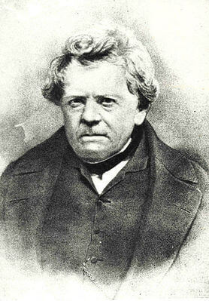
Electrons travelling around a circuit will encounter resistance.
Resistance has the unit ohm (Ω). It was named after the important physicist Georg Ohm.
If a component has a high resistance, it has more ohms.
If it has a low resistance, it has less ohms.

Slide 5
Every circuit component has a resistance.
If a component has a high resistance, it is hard for the current to flow through it.
This is because the electrons bump into each other lots as they flow through the component.

Slide 6
Some components have much lower resistance.
If a component has a low resistance, it is easier for the current to flow through the component.
This is because the electrons bump into each other less.

Slide 7
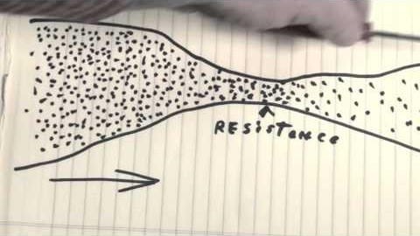
Resistance is important to consider in every circuit.
Watch this video (2:28) for an analogy of resistance.

Slide 8
The wires in a circuit also have a resistance.
We usually want these wires to have a resistance which is as low as possible.
We can change the resistance of the wire by changing its length, its width and the material it's made out of.

Slide 9

If a wire is made longer, its resistance will increase.
This is because the electrons have to travel further, so it is more likely that they will bump into each other.
The resistance of a wire doubles if you double its length.

Slide 10
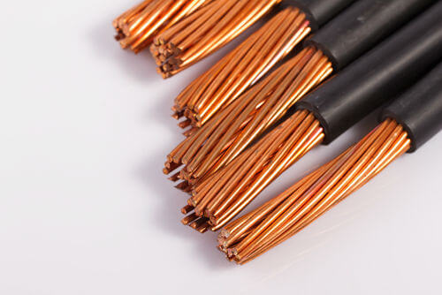
If you make a wire wider, its resistance will decrease.
This is because the electrons have more room to spread out, so it is less likely that they will bump into each other.

Slide 11
The resistance of a wire also depends on the type of material it is made out of.
A wire made out of metal has a much lower resistance than a wire made out of plastic.

Slide 12

Resistance is an important factor in wires, especially for carrying electricity over great distances.
Watch this video (0:41) for an explanation of resistance in wires.

